Slide 1

Agentic Business Profit Intelligence
AI-Powered Analytics for Smarter Business Decisions

Slide 2

The Problem: Data Overload, Insight Famine
Businesses today are drowning in data but starving for insights. Extracting real value is slow, expensive, and requires specialized data scientists. Decision-makers need clear answers, not complex spreadsheets.
The Gap
The Cost
The Challenge
Weeks to extract insights from raw data
Requires dedicated data science teams
Reports too technical for stakeholders

Slide 3




Our Solution: Automated BI Agent
One-click intelligence. Upload data, run AI analysis, get strategic insights in minutes. We've automated the entire analytics workflow, making data science accessible to everyone.
Upload Data
Run AI Analysis
Get Insights

Slide 4
Key Features
Simple UI
1
Upload CSV, no setup required
Auto Profiling
2
Instant data quality and correlation reports
Predictive Modeling
3
AI finds hidden drivers of profit and sales
Agentic Insights
4
LLM explains findings in plain English
One-Click Reports
5
Professional PDF ready to share

Slide 5

System Architecture
Frontend
Streamlit dashboard—clean, fast, intuitive.
Backend
Prefect workflow engine orchestrates the entire pipeline reliably.
AI Core
Scikit-learn builds models. LangChain generates insights.

Slide 6






Technology Stack
UI: Streamlit
Pipeline: Prefect
Seamless user experience
Reliable workflow management
ML: Scikit-learn
AI: LangChain + OpenAI
Powerful predictive models
Intelligent insight generation
Data: Pandas
Viz: Matplotlib, Seaborn
Efficient data handling
Professional visualizations

Slide 7

How It Works: Five Simple Steps
Upload
CSV file ready to analyze
Profile
Data health report generated
Analyze
AI pipeline runs automatically
Review
Model performance and insights displayed
Download
Professional PDF report ready

Slide 8
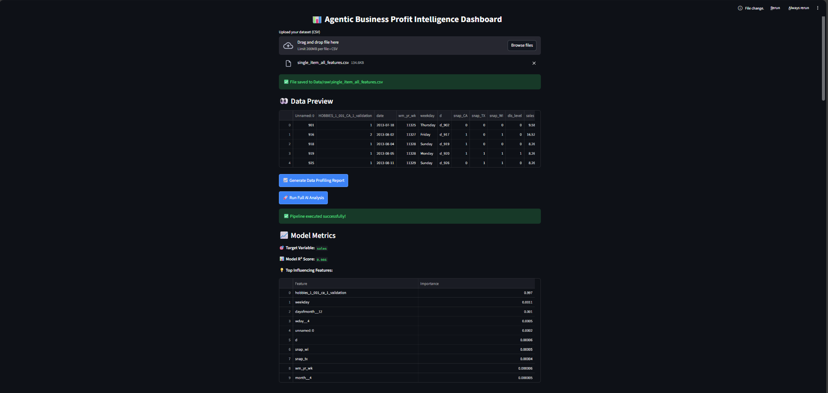
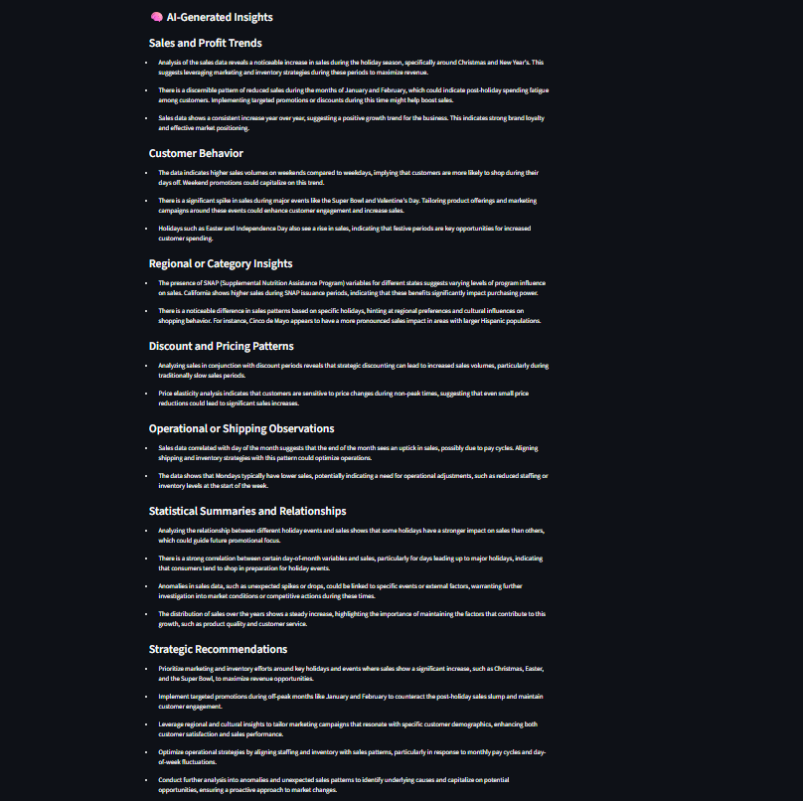

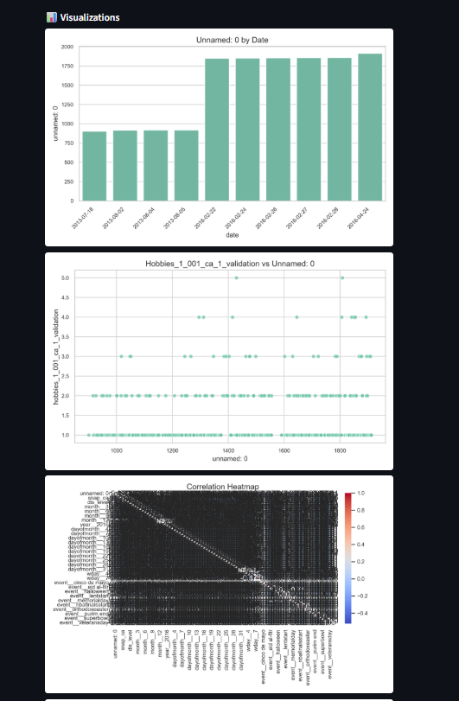
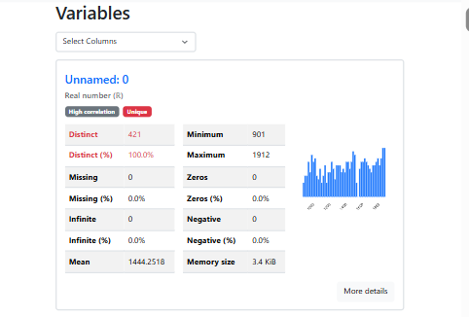
The Agentic
Our Agentic Approach
AI bridges the gap. Analyzes findings and translates them into concrete business recommendations.

Slide 9

Sample Output: Real Results
0.85
Model Accuracy
R² score measuring prediction quality
Top Influencing Features
Marketing Spend
Customer Satisfaction Score
Region
"Marketing Spend has the strongest positive impact on profit. For every dollar increase, expect significant return. Customer satisfaction is the second most critical factor..."

Slide 10

The Business Value
⚡ Save Time
💰 Reduce Costs
Weeks of analysis compressed into minutes
Less dependency on large data science teams
👥 Empower Teams
📊 Better Decisions
Business users get answers directly
Strategic choices backed by clear, interpretable recommendations

